Slide 1
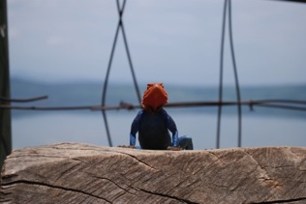
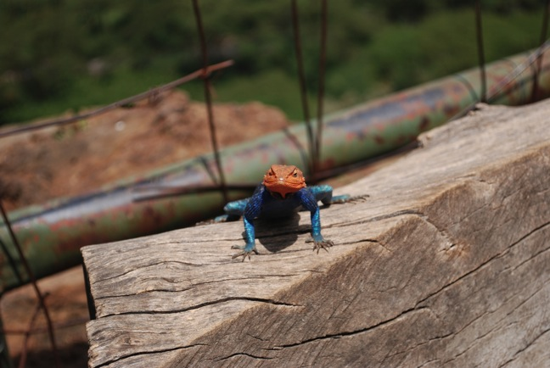
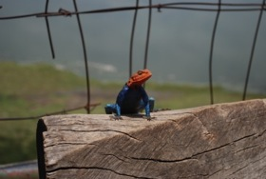
Eldoret, Kenya ~ East Africa
A life of purpose …
take the next step and become a Trainer
Infant Massage WINC
World Institute for Nurturing Communication
dba for the IAIM® grassroots organization, origin 1970’s in the USA, Inc. 1986
September 2010
The Dream of Africa is Realized

Slide 2
32 hours later, and very exhausted, we arrive at Brian’s house and I meet my roommate, Faith. Protocol is that all conversations are centered around ‘Tea’. From LAX I arrived in Nairobi, met up with Morgan and her family, room mate Faith and then took a commuter flight to Eldoret where our gracious host, Brian and his brother provided each of us a room in his personal home.

Slide 3
Highway to Eldoret
Our last beautiful government highway … without potholes.

Slide 4
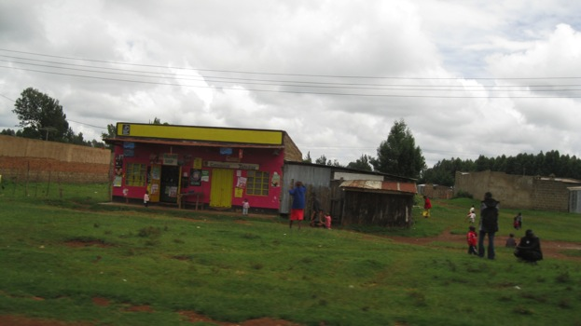
Roads Start to Decline
Business huts Along the Roadside

Slide 5
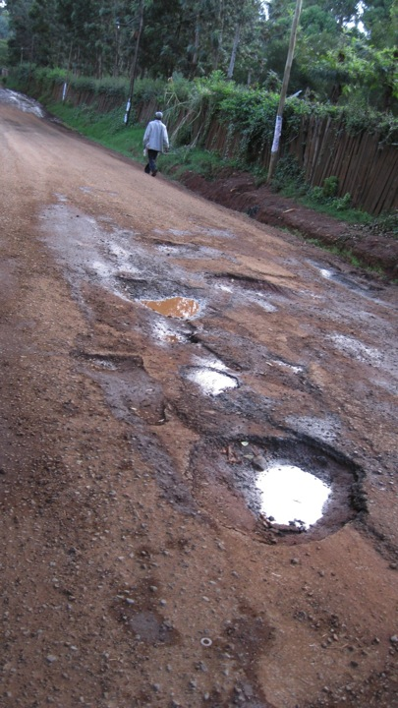
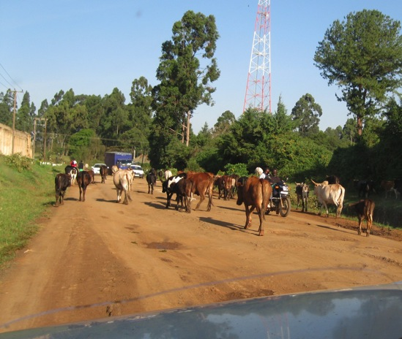
Road conditions just before the University.

Slide 6
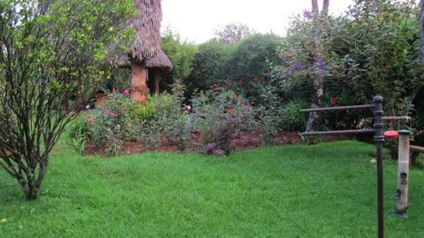
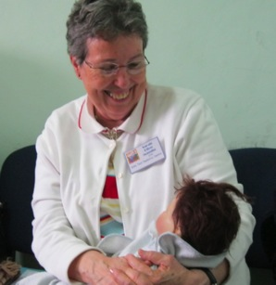
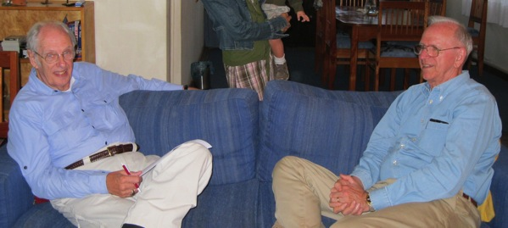
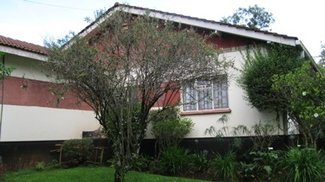
Miss Sarah and Dr. Joe’s Home Dr. Joe (orthopedic surgeon) is head of the medical university and assists the AIDS epidemic in nearby villages. His goal is to correct AIDS in utero. His wife Miss Sarah graciously extended her home to us and hosted our stay. Thank You Miss Sarah and Joe for the many comforts extended to us in your home!
Miss
Sarah
The Gardens
Miss Sarah’s home at the University
Mike
Dr. Joe

Slide 7
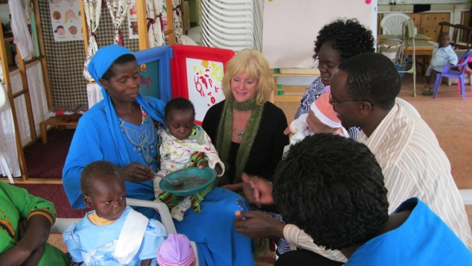
Students in class
“47% more weight gain, massage 15 minutes, 3 times a day”.
EBS, Tiffany Field
Students next day teaching visiting villagers and their children at the Sally Test Center

Slide 8
Students practicing for teaching the parent classes

Slide 9
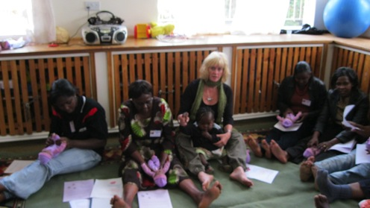
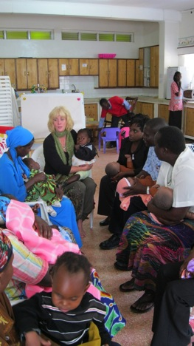
Andrea and Miss Sarah at the Sally Test Center.
Where touch games, songs, and dance lift the human spirit and life begins to be renewed.
The students practice teaching the villagers at the Sally Test Center and later that morning they are teaching the children and women of Eldoret.

Slide 10
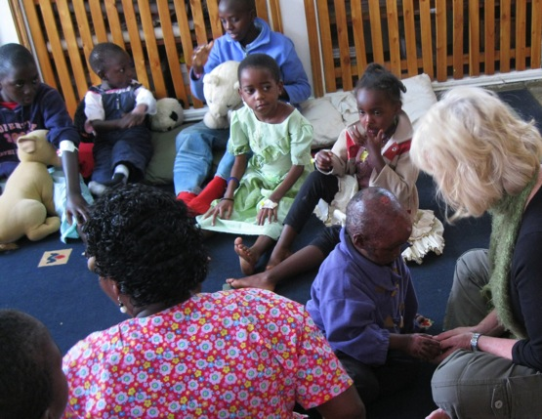
Sidney was a burn victim. His Mother went home to her parents due to abuse and his father set the family home on fire and burned the two grandparents, mother, a brother and sister of whom did not survive, and only Sidney and one sister were able to be saved. Song, dance, and nurturing touch helped to ignite Sidney’s will to survive and thrive. I whispered to him “There’s hope Sidney through you to have a good life”.

Slide 11
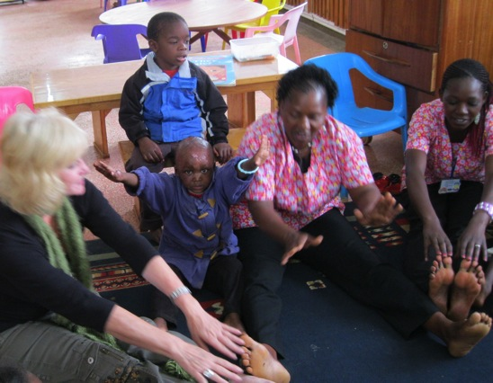
Sidney shouted out loud in the middle of our exercise, “Sidney … … yes! ”. He and I connected in a very deep way and when I close my eyes I can feel his little hand in mine and all the hope his touch revealed.

Slide 12
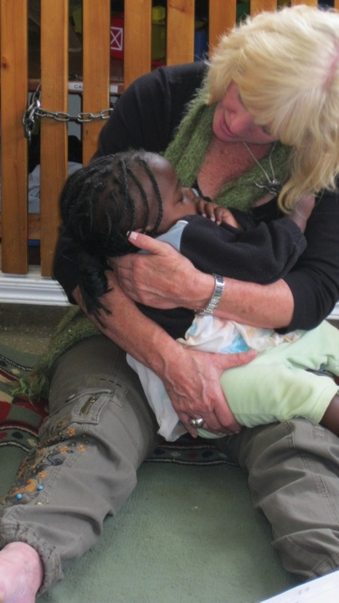
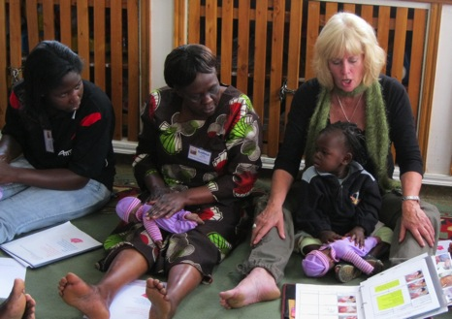
This is baby Mary. She was abandoned by her mother on more than one occasion because she could not afford the medical treatment that was needed. Mary chose me to play with her daily and I noticed she did not like to play games on her back so we repositioned her supporting her back and she participated completely until falling fast asleep.

Slide 13
Women selling produce along the roadside on the way to safari

Slide 14
Bravo, Graduation Day for 17 Kenyan Brothers and Sisters
The students are in Alphabetical order: Teacher -Andrea Kelly, Hosted by Miss Sarah and Morgan Livingstone.
Caroline Kemunto, Elizabeth Kabuthi, Elsie Birgen, Esther Opuck, Ernest Kirui, Faith Barasa, Jane Kamau, Joyce kimani, Maggie Anyango, Martha Mwongela, Moses Orwe, Rebecca Chumo, Regina Njoki, Ruth Otieno, Salesa Abuga, Salina Yego, Sarah Mamlin, Timothy Wekati, Vivian Simatei

Slide 15
Graduation Day Dance is the universal language to celebrate life’s accomplishments and honor their guest. Eleven different tribes were represented in this group.

Slide 16
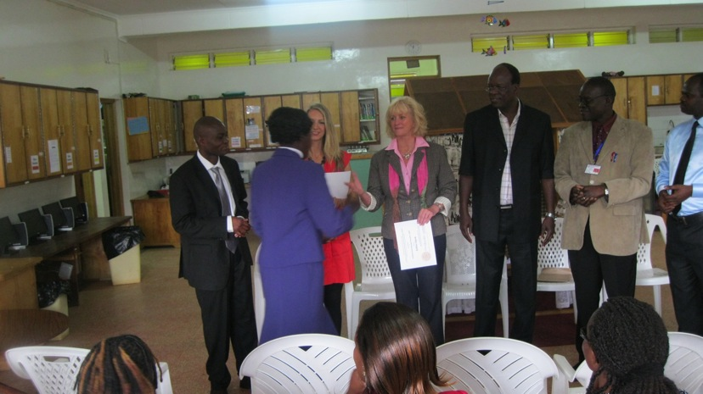
The Administrators of the Kenyan government honored our class by coming to graduation and telling us that our program of nurturing touch, compassionate communication, and positive environment would be implemented into the University, Social, and Hospital systems of Kenya.

Slide 17
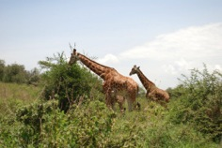
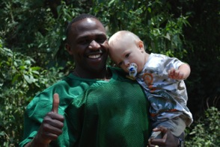
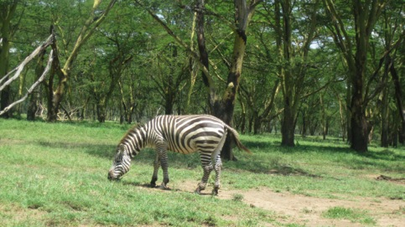
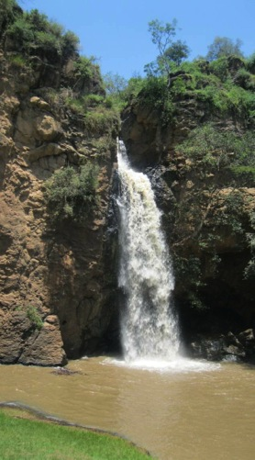
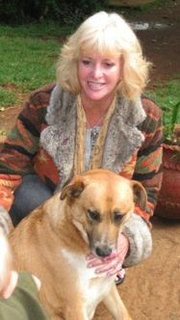
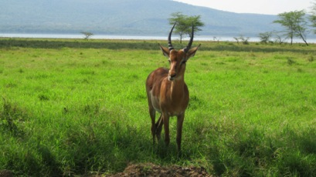
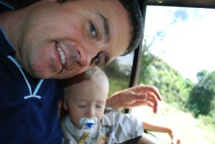
Miss Sarah treats us to Safari, a wondrous day indeed
Tired Finn in Dad Mike’s lap
… day’s end, safari’s over.

Slide 18
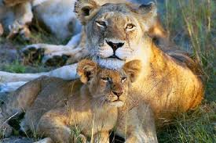
Goodbye for now Africa A life of purpose fulfilled
“I dreamed of going to Africa and now I dream of once again visiting my beautiful Kenyan friends and their children.”
Andrea Kelly
end

